Slide 1
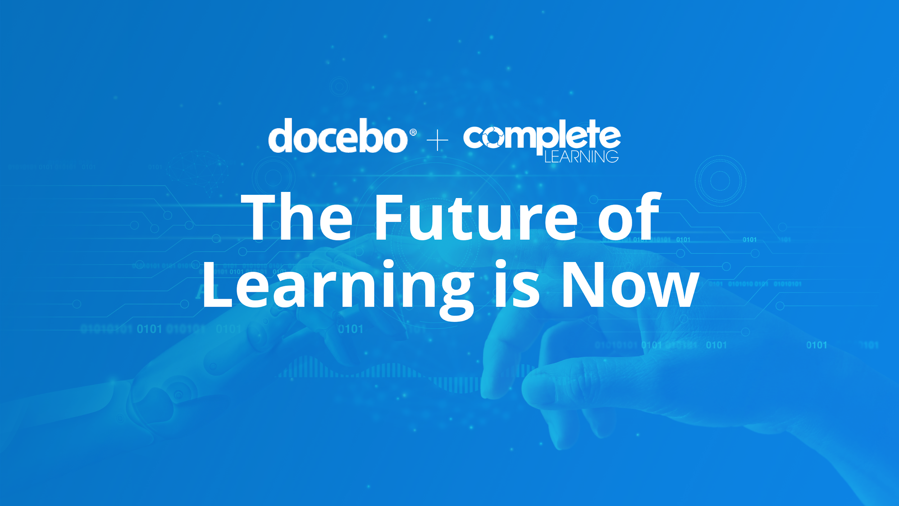

Slide 2



Our Presenters Today
Rick Swaleh
Account Executive, Docebo
Beryl Oldham
Managing Director, Complete Learning Solutions

Slide 3
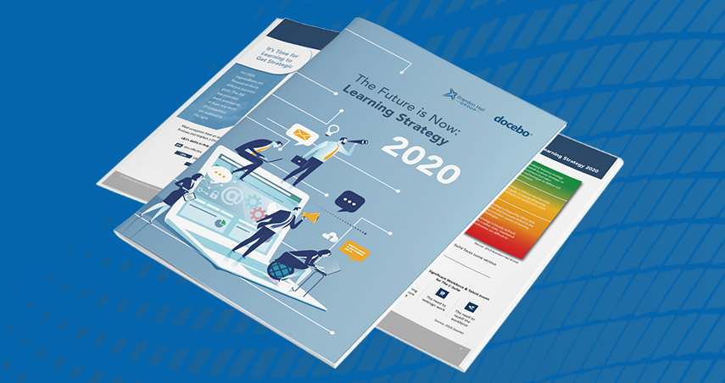
https://www.docebo.com/resource/future-of-work-enterprise-learning-strategy-2020-report/

Slide 4
Stay Ahead of The Competition With a Top-Notch Learning & Development Strategy

Slide 5
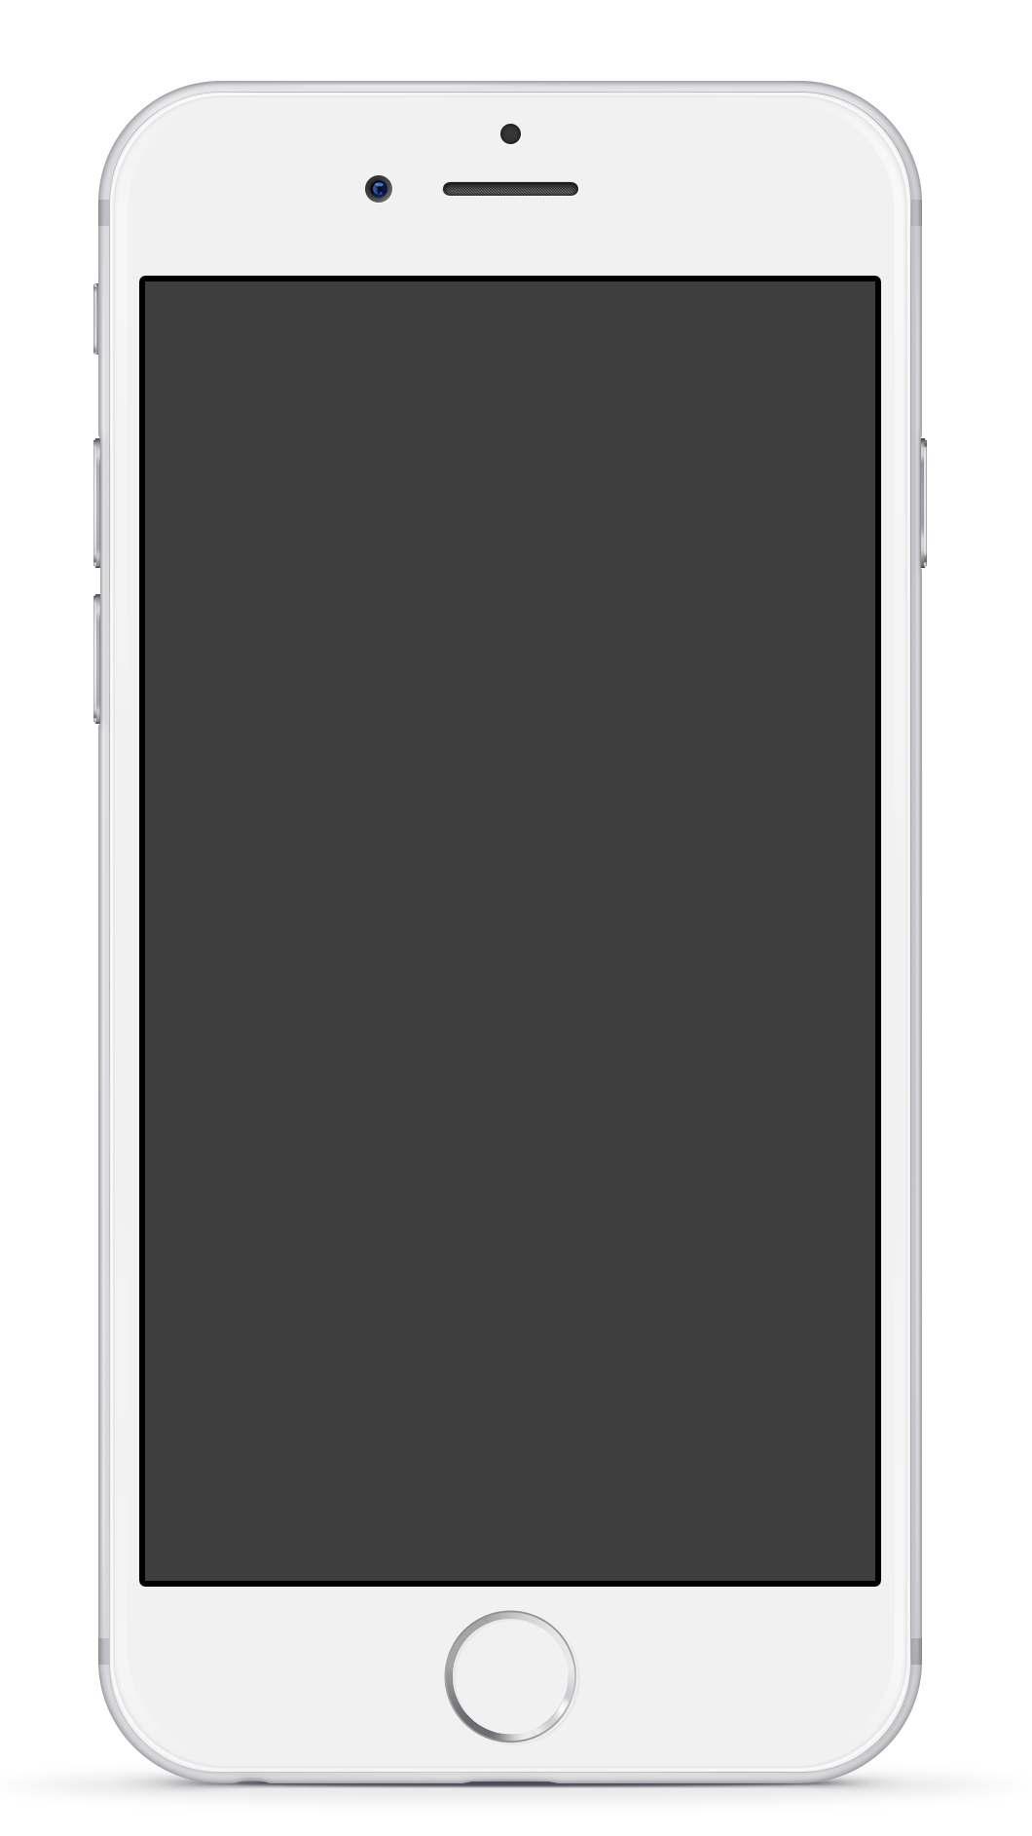
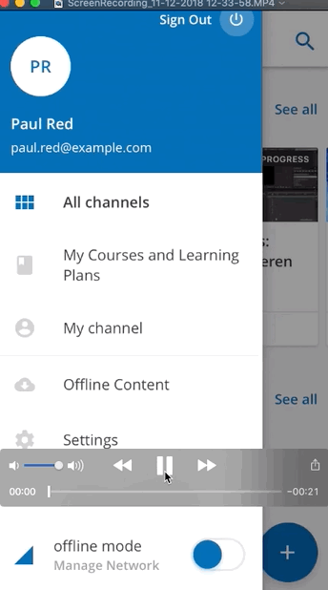
4 Trends in Learning And Development
Social and collaborative tools
Mobile Learning
Business intelligence
Satisfying the needs of multiple learner
audiences

Slide 6
How Are Businesses Approaching Innovation?

Slide 7
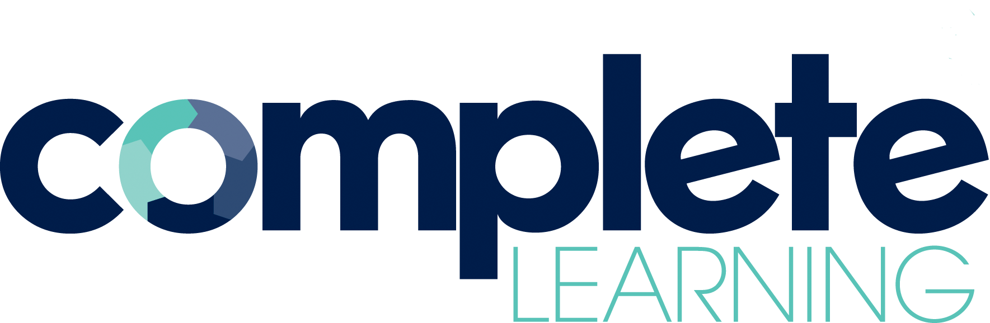

My name is Beryl Oldham and I am the Managing Director of Complete Learning Solutions.
As our name suggests, we provide a complete range of solutions that cover every aspect of organisational learning and development.
We are proud to partner with Docebo in the APAC Region and we offer sales, service, and administrative and technical support.
If you would like a copy of these slides after the presentation, please download from https://www.completelearning.co.nz/resources

Slide 8
The future of learning is now…
Workplaces are undergoing radical changes in 2020, creating a new normal for both organisations and individuals.
We are in the midst of a massive, fast-paced shift and there will be an enduring impact on work and workplaces. To quote Dianna Vienne https://www.fastcompany.com/90496811/5-changes-to-expect-in-the-workplace-after-covid-19, “Even the word “workplace” suddenly seems obsolete, as the physical location in which we now work has merged with the places in which we eat, sleep, learn, exercise, and play.”
The implications for L&D teams are immense: their work will need to change to support new business needs as well as individuals who have now enjoyed more flexibility and autonomy in their working practices.
- Jane Hart https://www.modernworkplacelearning.com/cild/

Slide 9
The future of learning is now…
Remote working will not go away and neither will remote learning.
We have a growing skills gap as people struggle to keep up with the pace of change.
Organizations must deliver personalized learning opportunities to address current and future needs.
Corporate learning must be linked to overall business strategy where outcomes equal business results.
Good learning analysis and design have never been more important.

Slide 10
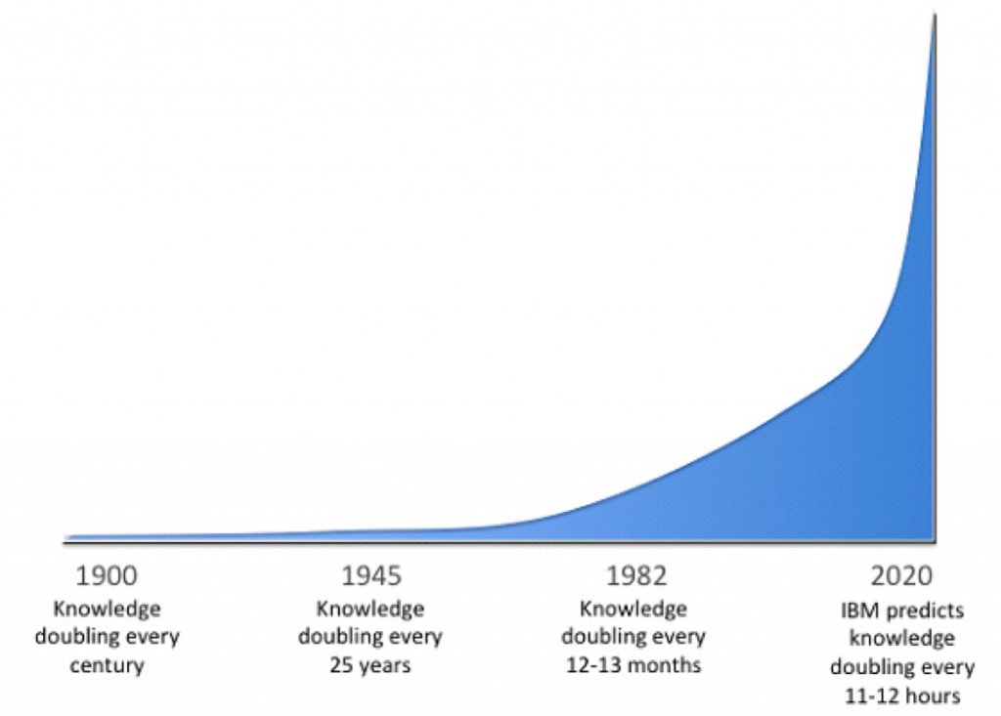
The growing skills gap…
In his 1982 book, Critical Path, futurist and inventor R. Buckminster Fuller estimated that up until 1900 human knowledge doubled approximately every century. By 1945 it was doubling every 25 years, and by 1982 it was doubling every 12-13 months. IBM now estimates that in 2020 human knowledge will be doubling every 12 hours.

Slide 11
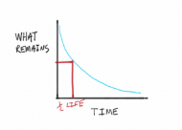
The growing skills gap…
But although information itself is growing exponentially, the half-life of knowledge (or facts) is decreasing. Wikipedia defines this as, "The half-life of knowledge or half-life of facts is the amount of time that has to elapse before half of the knowledge or facts in a particular area is superseded or shown to be untrue.”
Conclusion:
“The faster the pace of knowledge change, the more valuable the skill of learning becomes.”
      - Shane Parrish, author of Half Life: The Decay of Knowledge and What to Do About It

Slide 12
We need to make learning flexible and easy…
So what is the work of L&D in the Modern Workplace?
Jane Hart https://www.modernworkplacelearning.com/ talks about the 4 D’s of learning and how L&D can promote and support them through Directed Learning (L&D doing things for people to learn from) and Supported Learning (L&D helping people to do things themselves to learn), while encouraging Self Learning (Individuals doing things themselves to learn).
DIDACTICS (Formal Learning) – Being taught
DISCOVERY (Informal Learning) – Finding things out for oneself
DOING (Experiential Learning) – Learning from the work
DISCOURSE (Social Learning) – Interacting with others

Slide 13
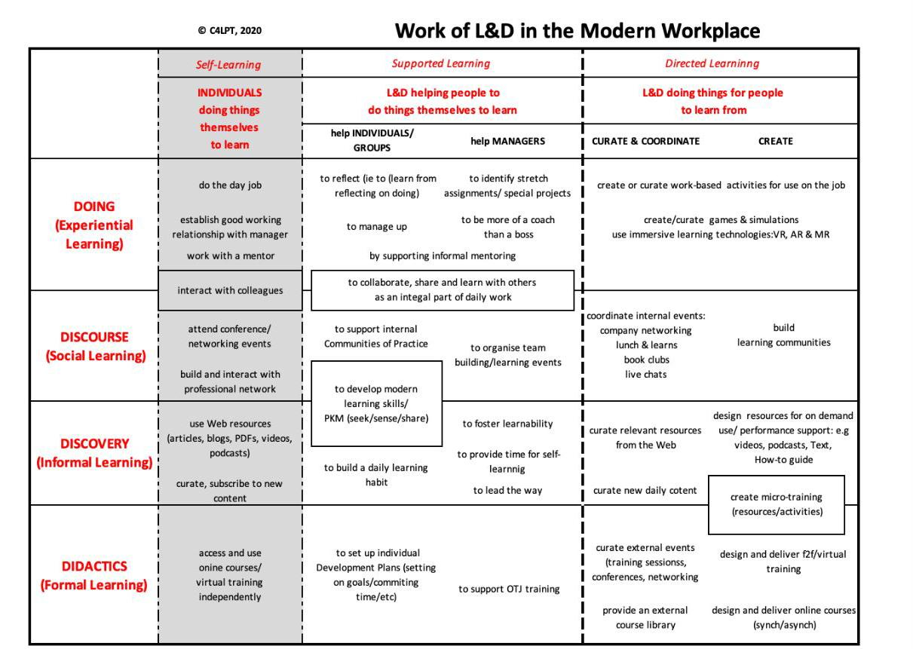

Slide 14
So let’s deliver personalized learning…
…that can be delivered remotely.
This is where your learning platform comes in, which is more than a traditional LMS. A good learning platform will be the “go to” place where people can find and share information about everything they need to perform well in their current roles and develop for their future roles.
Your learning platform can be designed to host content and allow collaboration in ways that address the initiatives listed in Jane Hart’s Modern Workplace matrix.
LMS | Learning Platform
Designed for managing training Designed for LMS admins Formal learning only | Designed for learning experiences Designed for learners Formal and social learning

Slide 15
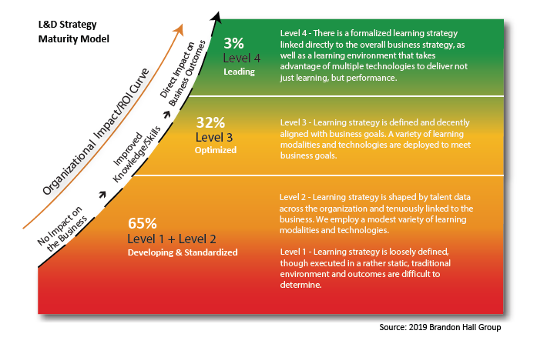

Slide 16
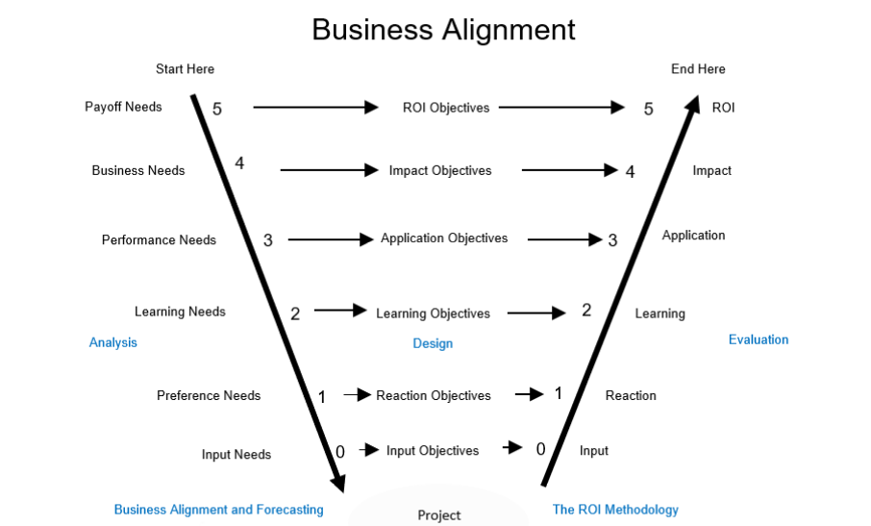


Slide 17
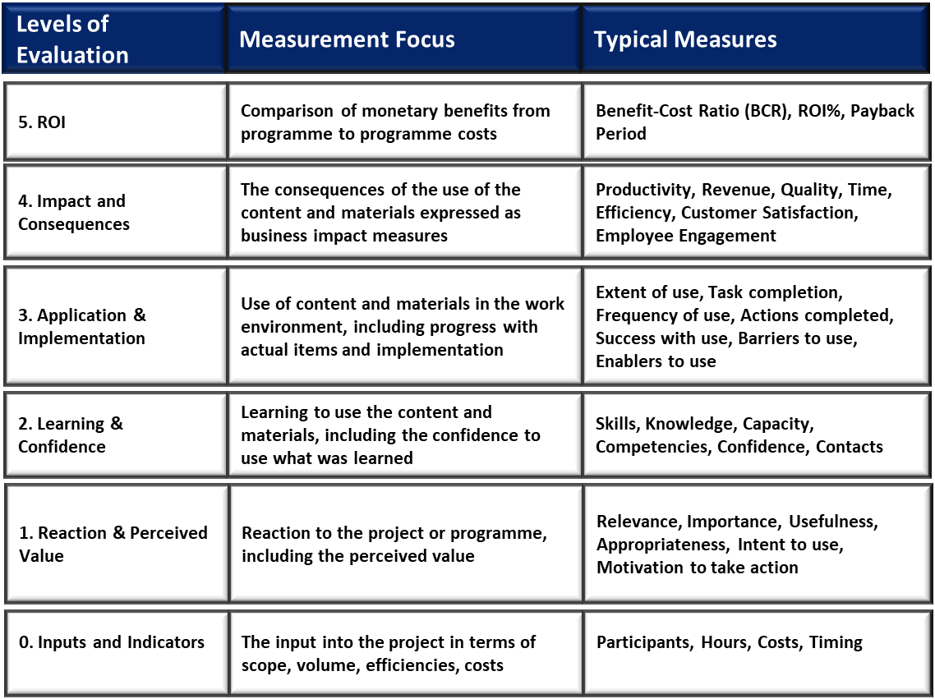

Slide 18
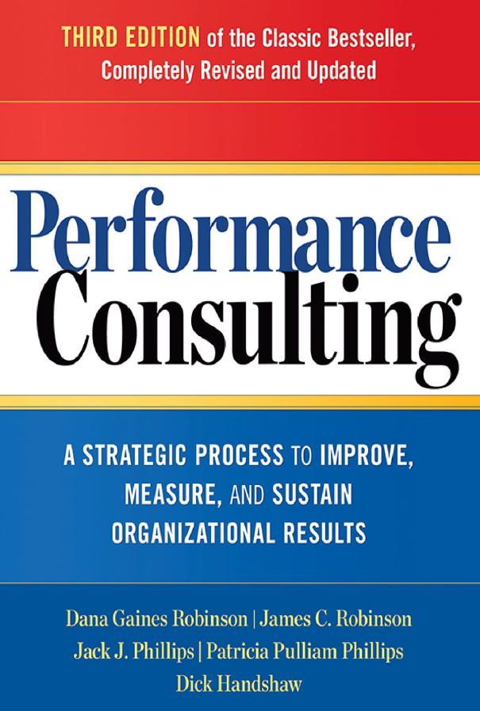
I am sharing this book with you because it is my “bible” when it comes to analysing performance issues and because it will help you stay strategic with your L&D design.

Slide 19
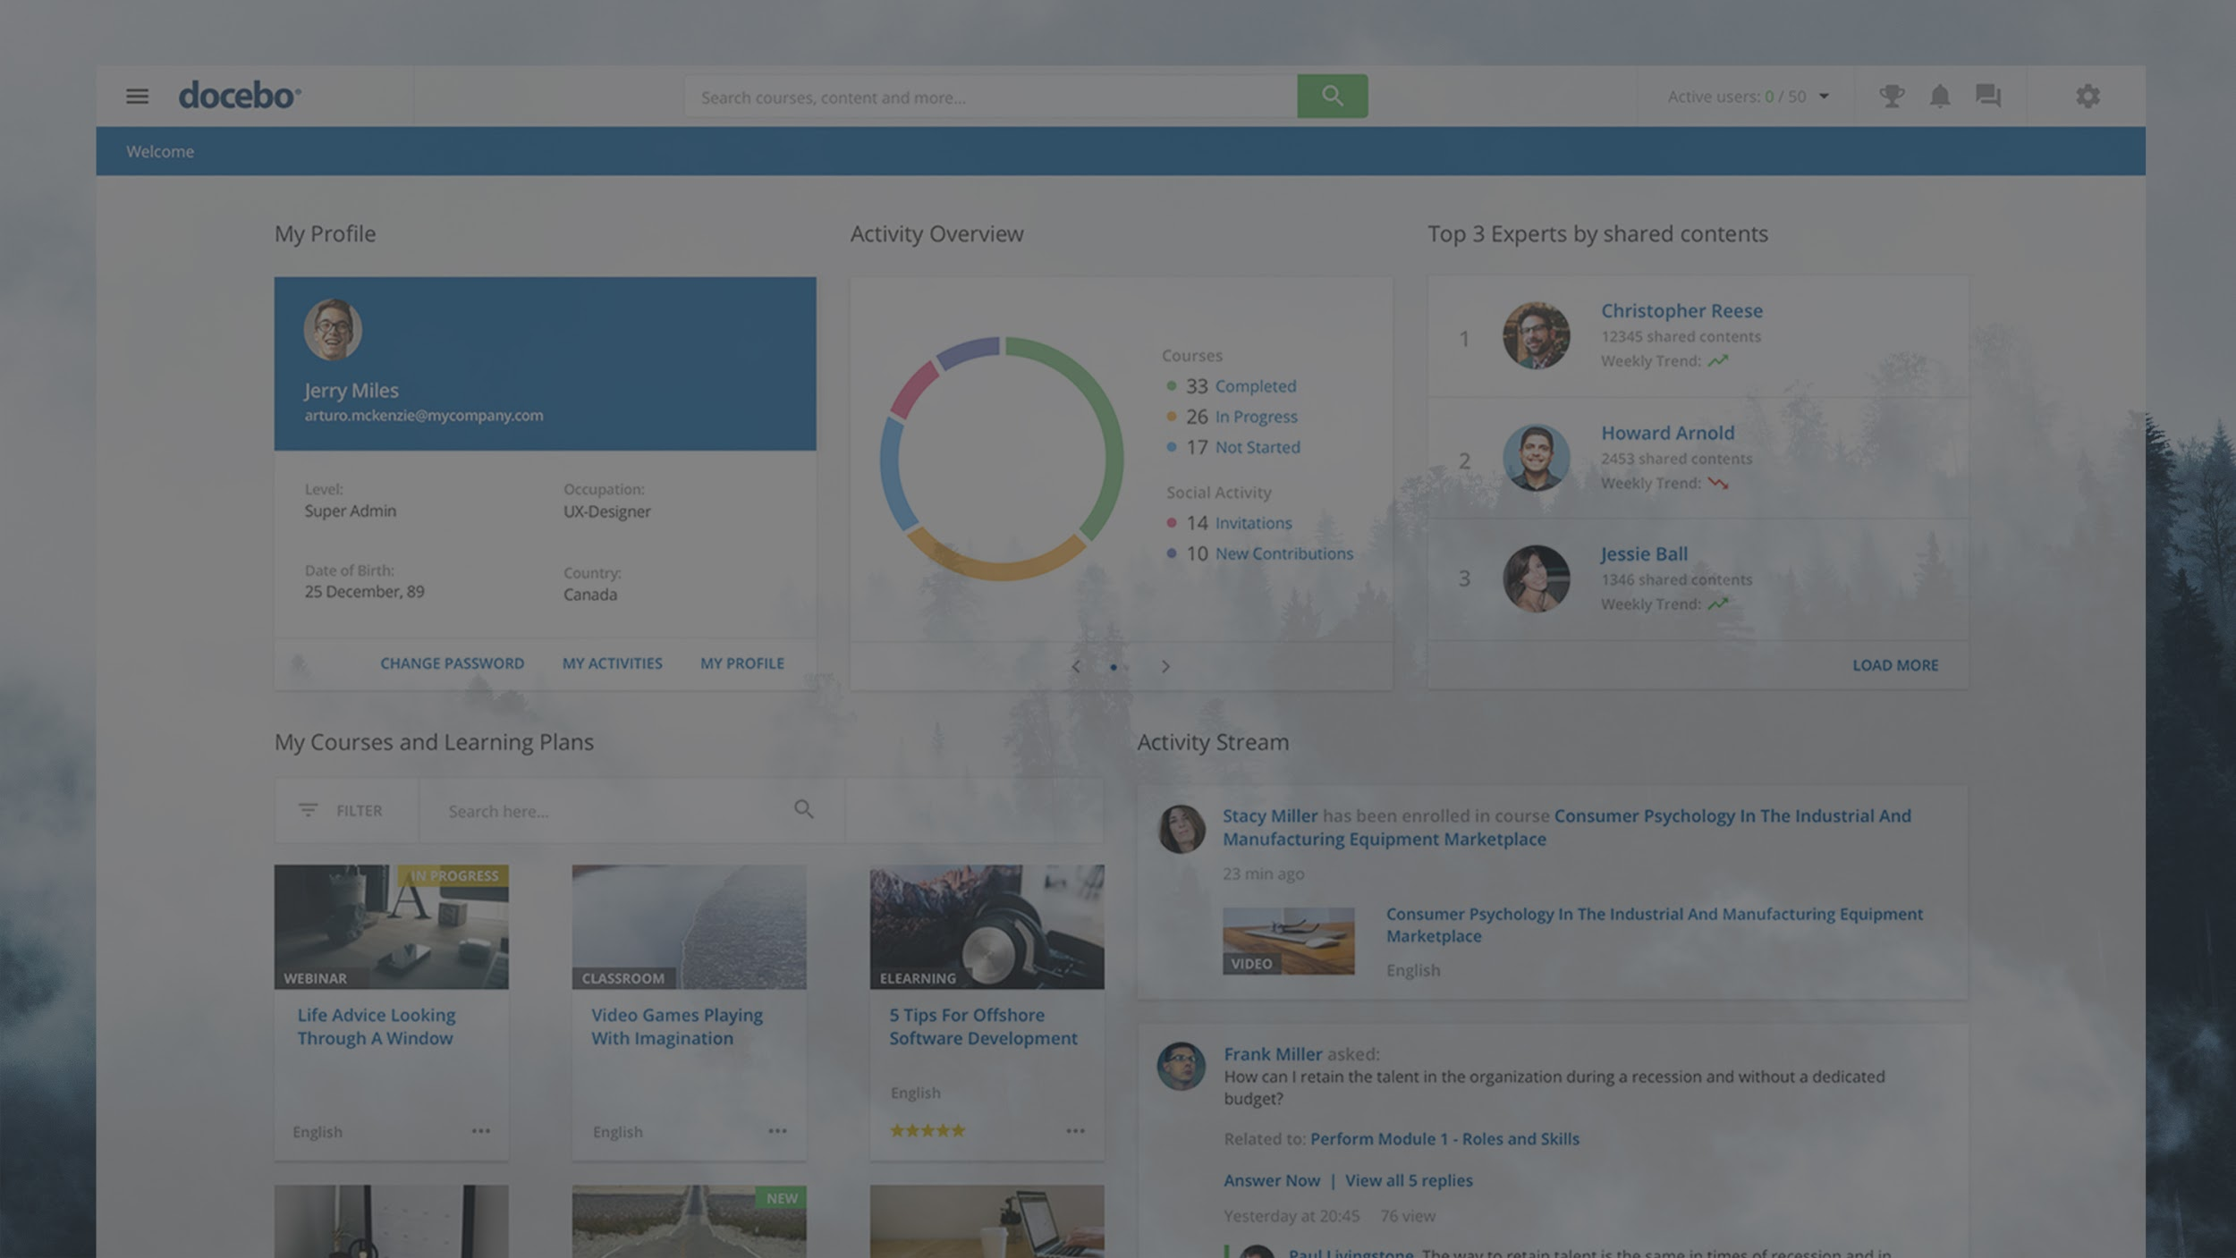

Learning Platform
Drive employee, partner, and customer growth
Increase people and business performance
Drive revenue
Retain top talent

Slide 20
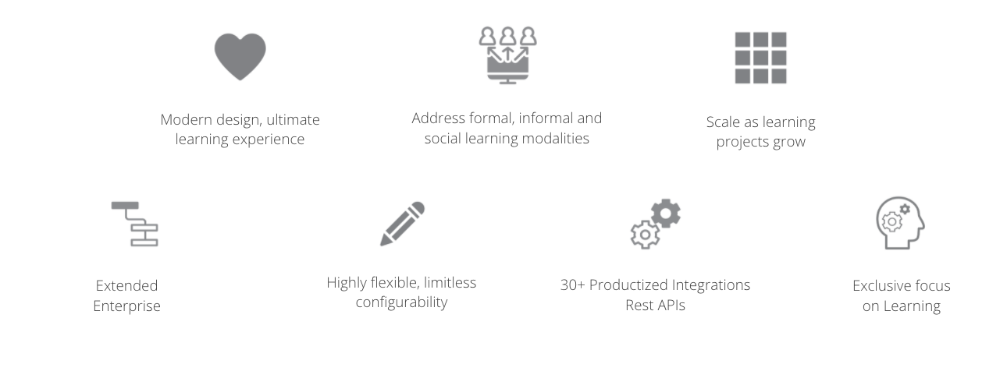
OUR UNIQUE STRENGTHS
Releasing first to market, learner-centric technology at an unmatched pace in the industry

Slide 21
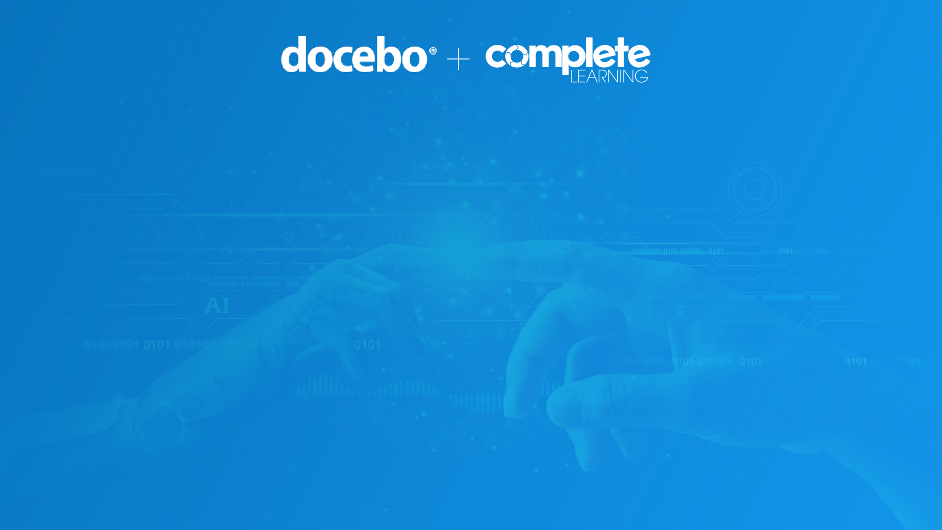
Thank you www.completelearning.co.nz
www.docebo.com

